Slide 1
MTH 522 Presentation: Predicting NHL Shots on Goal Brian Cornet
April 27th, 2021

Slide 2
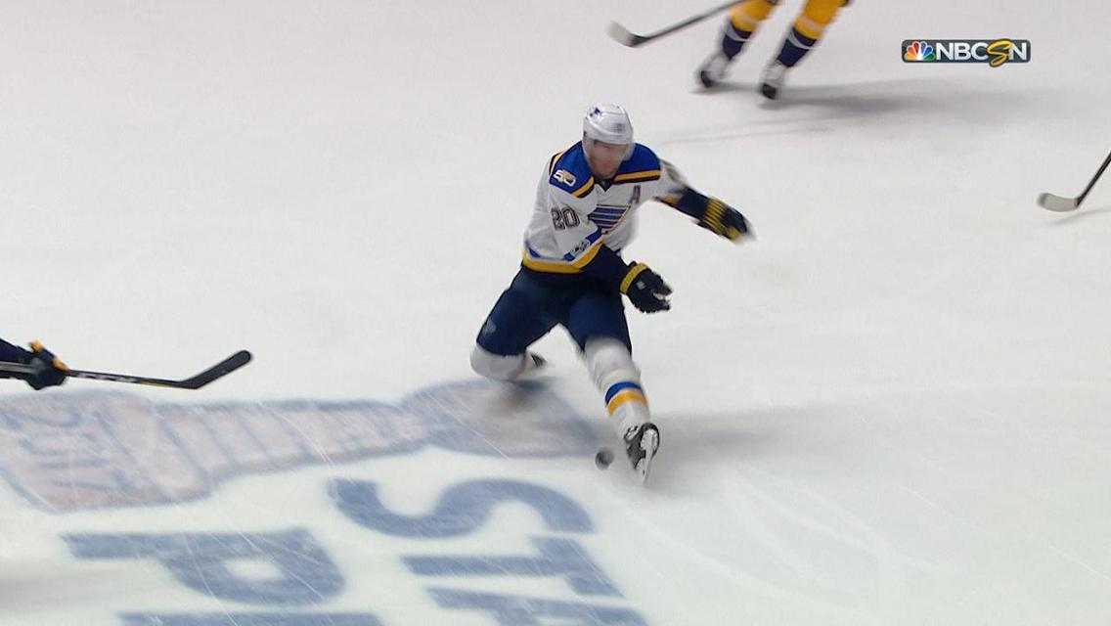
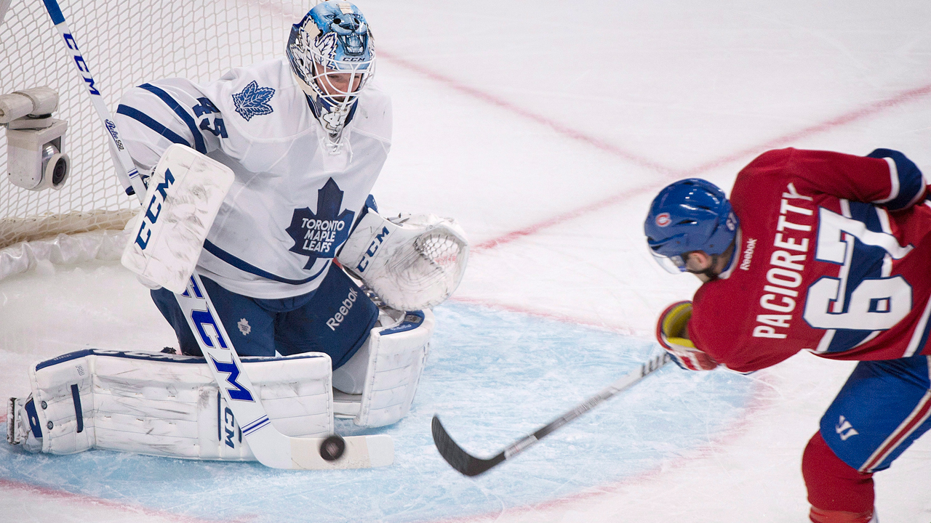
Background
The National Hockey League (NHL) provides data publicly from its API:
https://statsapi.web.nhl.com/api/v1
This dataset includes all game “plays” from 2000-2001 season to 2019-2020 season:
https://www.kaggle.com/martinellis/nhl-game-data
Has been suggested that predictive modeling for hockey is extremely difficult compared to other sports
Shot Blocked:
The puck is stopped or redirected by a skater using either their stick or their body (ouch)
Shot on Goal:
The puck is stopped or redirected by the goalie OR the puck goes in the net (goal!)

Slide 3
Data Overview
This model attempts to predict shots on goal vs. shots blocked by skaters (as reported by the NHL API) using API-provided variables:
play_id, game_id: index values for individual plays (game_plays.csv) and games (game.csv)
team_id_for, team_id_against: index values for involved players (team_info.csv)
event: category for a play; Faceoff, Hit, Penalty, Shot, Goal, etc.
secondaryType: subcategory for certain events such as shot types (slap shot, deflection, etc.)
x,y, st_x,st_y: coordinates on ice (in feet); absolute and relative to player’s goal respectively
period, periodType: REGULAR for periods 1-3, OVERTIME for 4+, SHOOTOUT for 5 (regular season)
periodTime, periodTimeRemaining: time (in seconds) since start and until end of period
dateTime: timestamp of event (GDT)
goals_away, goals_home: current score based on home/away teams (NOT team_id_for/against)
description: full text description of event; players involved, actions, etc.

Slide 4
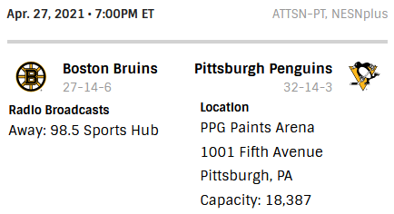
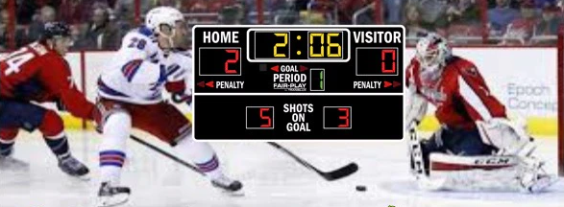
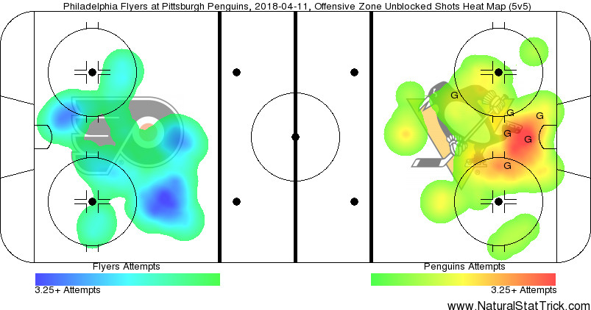
Attributes Used
Joined dataset with game.csv to make the following changes:
Added playoffs; 0 = regular season, 1 = Stanley Cup Playoffs (generally more intense)
Added season as integer for season number (e.g. 2019-2020 → 20)
Identified shooter by home/away status to create shooterHome; 0 = away team, 1 = home team
Mapped goals_home and goals_away to shooterGoals and defenderGoals based on the above
Binarized periodType to overtime and shootout; event to onGoal (1 = shot/goal, 0 = block)
12 predictors used that describe the shot setting, shot time, and shot position
Tonight!

Slide 5
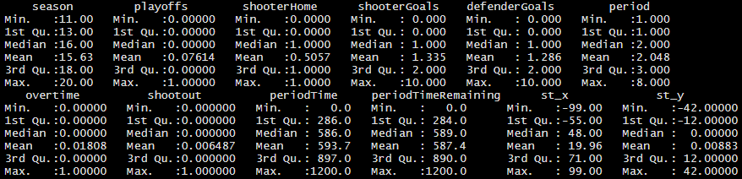
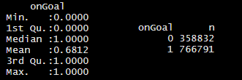
Sample Selection
Focus is on shots blocked vs. shots on goal: event must be “Blocked Shot”, “Shot”, ”Goal”
Removed all entries with NA values in relevant attributes using is.na() from R base
Includes all entries prior to 2010-2011 season; this is when NHL’s API started reporting coordinates
Removed all duplicate entries in dataset using duplicated() from R base
All entries in Kaggle dataset starting from the 2018-2019 season are listed twice for some reason
Split dataset into two without replacement using createFolds() from R caret package
Final data size: 1,054,130 entries Training set size: 527,065 Testing set size: 527,065

Slide 6
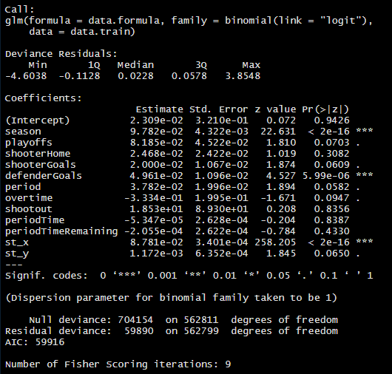
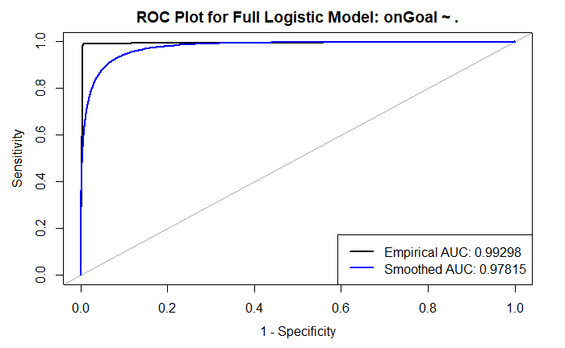
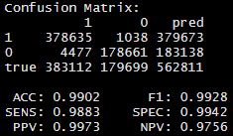
Logistic Regression Model
Very high accuracy for this model!
st_x z-value of 258, p-value floored to 0 in memory
season z-value of 4.527, p-value of 2.122916e-113

Slide 7
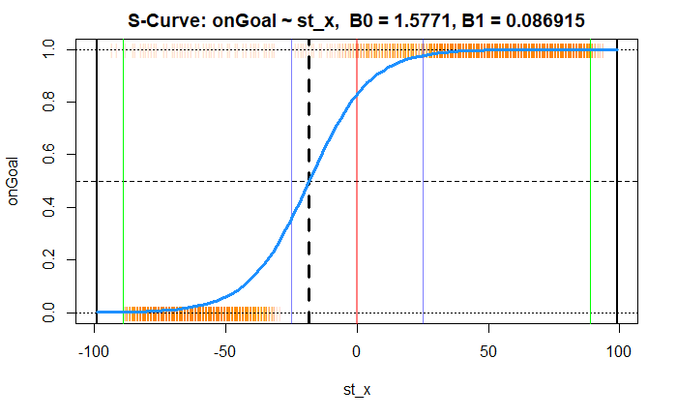
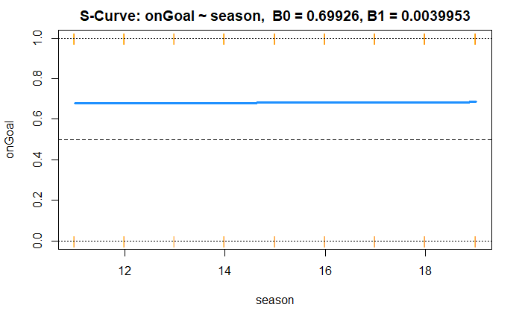
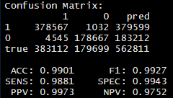
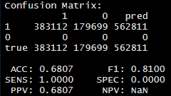
Simple Logistic Regression Models
st_x is extremely significant! S-curve midpoint is -18.146 (just outside the defensive zone)
season is terrible; s-curve midpoint is -175.023 (calendar year 1825)

Slide 8
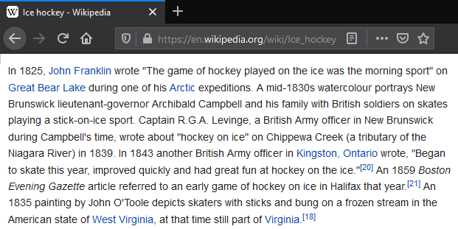
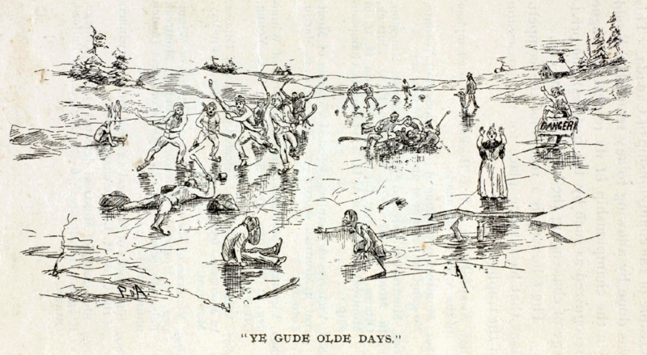
Simple Logistic Regression: season
season is clearly not as strong as the original model suggests, at least not independently (sure is funny though)

Slide 9
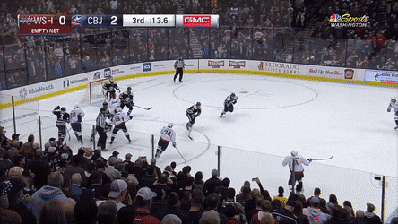
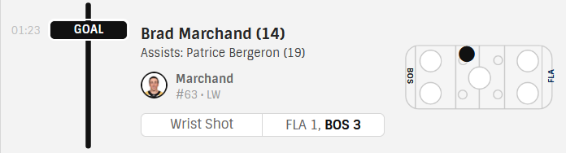
Simple Logistic Regression: st_x
Suggests NHL API arbitrarily defines blocked shots by distance; may be recategorized under “missed shots”

